Slide 1
ISM 6136
Data Mining
Dr. Tim Smith

Slide 2
Guiding Agenda
Creating and testing a number of polynomial regression models
Creating multivariable Regression Models
Basic Data Preparation and Predictive Modeling
The Trouble with Correlation

Slide 3
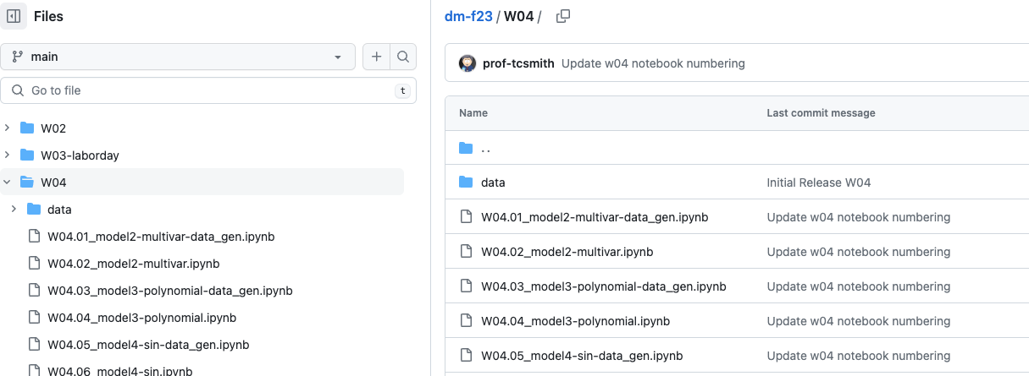
Follow along with the professor
Got to our classroom GitHub Repo
https://github.com/prof-tcsmith/dm-f23

Slide 4
Summary
Linear Regression
Single variable
Multivariable
Transformations (such as polynomial and other functions such as trig)
Developing a Predictive Model
Preprocessing data
Renaming columns
Identifying missing values
Imputing Values
Train/Test Split
Data Scaling
Model Fitting
Model Prediction
Model Scoring
Correlation and Other Details
Anscombe’s Quartet
Use of correlation matrixes and Pair Plot diagrams
Basics of Matplotlib and Seaborn

Slide 5
This week…
Complete Assignment #1
As discussed in the first class, you can work in with up to 2 others (3 total).
At the top of your notebook you must include the full name of each student that worked on the assignment.
If an assignment is a copy of another submission that isn’t part of the group; this will result in the academic penalty discussed in the first class (and found in the syllabus).
You can access the assignment details in Canvas.
Prepare for Quiz1, 2 and 3 (which will be given at the start of next class)
Optional: Complete the Bonus01 and Bonus02 DataCamp assignments.

Slide 6
Happy Learning!

